Slide 1
Chirp
Blogging webapp
By:
Pratik Sawant (59)
Sanket Sawant (60)
Kevin Shah(62)

Slide 2
Introduction
The project is Tweet streaming web application where users can upload Tweets and stream it at any point.The uploader is able to see how many users have viewed its Tweets.Users can like ,dislike the Tweets.only uploader can delete and edit the Tweet title and description of Tweet.

Slide 3
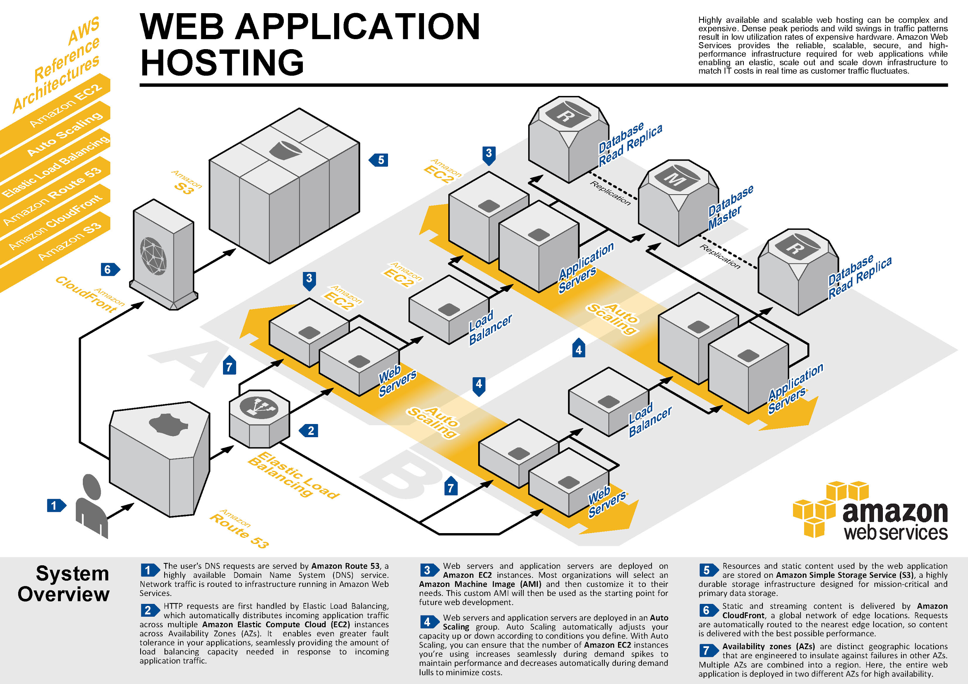
Services

Slide 4
Implementation
Technologies Used
1. Frontend
HTML
CSS
Javascript
AngularJs
2. Backend
Nodejs
Mongodb

Slide 5
Conclusion
A Cloud storage system for Tweet storage and Retrieval was successfully implemented and hosted on AWS Cloud services.

